Slide 1

Sparta Community-Hunter Field
Airport
Illinois Aviation
Economic Impact Study
[Insert Date]
Notes:
The Illinois Department of Transportation (IDOT) Aeronautics Division partnered with Kimley-Horn to develop the Illinois Aviation Economic Impact Study. The Illinois Aviation Economic Impact Study was conducted in concert with the Illinois Aviation System Plan (IASP). Both studies used data collected for Calendar Year 2019. For that reason, this study largely does not incorporate any impacts from the COVID-19 Pandemic.

Slide 2



What is Aviation Economic Impact?
Conveys the economic importance of airports and tells the story of how airports support and enhance the Illinois economy
Notes:
This study quantified the economic contributions of individual airports at the regional and statewide level and how they impact the economy. The study summarized the benefits, both quantitative and qualitative, that airports provide to residents and businesses; calculated the impact of off-airport freight/air cargo; and included case studies based on the unique contributions of various organizations in the state. The economic impact provides tools to inform and educate a diverse, public audience on the vast benefits of aviation in the state. Measures of economic impact and our airport’s individual economic impact findings are provided in later slides. Together, the analyses of the Illinois Aviation Economic Impact Study provide a comprehensive assessment on the role and benefits of Illinois’ airports, both in terms of numbers and telling the stories of the wide diversity of contributions that airports make to Illinois.

Slide 3
Primary Objectives
IDENTIFY
CALCULATE
QUANTIFY QUALIFY
On-Airport Impacts
Jobs
Net Economic Contributions
Labor Income
Visitor Spending Impacts
Value Added
Other Economic Impacts
(Case Studies)
Freight/Cargo Impacts
Total Economic Impact
Notes:
The primary objectives of the Illinois Aviation Economic Impact Study (or EIS) were to identify the key components of aviation-related economic impacts, calculate impacts using the IMPLAN economic modeling software, and quantify the total economic impacts of the Illinois aviation system. This study evaluated quantitative data in terms of net economic contributions and developed case studies based on the unique contributions of aviation to the state, especially those that contribute to the quality of life of Illinoisans. This study used data collected from 2019 and as a result shows the findings from the system in 2019, without accounting for the effects of the COVID-19 pandemic. We’ll talk more in more detail about the types of impacts and the metrics used to quantify the economic contributions in later slides.

Slide 4
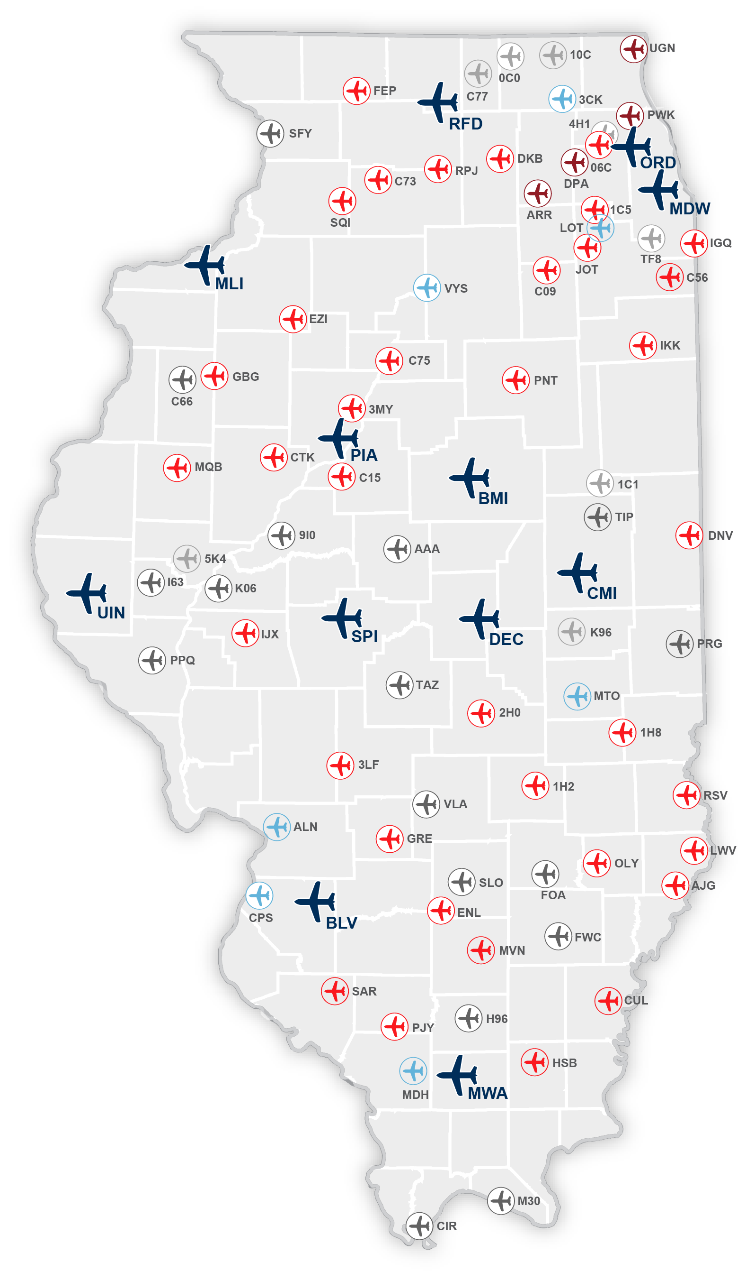
IDOT Study Airports
Notes:
The Illinois Aviation Economic Impact Study analyzed 85 public-use airports across the state.
Of these 85 airports, 12 are Commercial Service and 73 are General Aviation (GA) airports.

Slide 5
Methodology Overview
Notes:
The following section provides on overview of the methodology employed to estimate the economic impacts, including definitions of the terminology used in the study.

Slide 6


Economic Impact Categories
Category | Meaning
On-Airport Activity | Impacts related to the activity of airport administration, business tenants, and capital improvements on airports
Visitor Spending | Impacts related to out-of-state visitor spending at both commercial service and general aviation airports
Freight/Cargo Activity | Impacts related to air cargo operations; available only at the regional or statewide level
Notes:
There are three categories that were used to describe economic impacts and derive the total impacts by airport, region, and for the state. This table presents the three categories used in the Illinois Aviation Economic Impact Study including a definition of each. When the total economic impacts are presented, they represent the summation of the on-airport activity, out-of-state visitor spending, and freight/cargo activity. Freight/cargo activity is unique as it reflects an analysis of off-airport air cargo that assesses the reliance of off-airport industries in Illinois on off-airport air cargo that is transported through Illinois airports. The economic contributions of this air cargo to off-airport businesses are calculated on both the statewide and regional bases, not for individual airports. This analysis does not include the impacts of on-airport air cargo jobs such as FedEx or UPS, which are covered by other components of the Economic Impact Study.

Slide 7



Economic Impact Measures
Jobs: Number of employed people, including full-time and part-time
Labor Income: Total employment compensation paid to all employees, including salaries, wages and other benefits (e.g., healthcare insurance payments, retirement); also known as “payroll” or “total compensation”
Value Added: The economic productivity of each aviation-related business establishment. Value added is calculated as business revenue earned minus the cost of purchasing goods and services from other businesses. Value added includes all labor compensation, profits, and taxes paid by businesses. Value added is a reflection of the aviation system’s total contribution to Illinois’ Gross Domestic Product (GDP)
Economic Impact: Total economic impact takes into account expenditures needed to administer airports, sales of goods and services by airport tenants, budget expenditures by public sector agencies located on airports, the cost of capital expenditures, and visitor spending in Illinois’ hospitality-related sectors; also known as “business revenues”
Notes:
The economic impacts of airports are expressed in terms of jobs, labor income, value added, and economic impact, with the definitions of each term provided.
It should be noted that the four economic impact measures shown should be considered independently and are not additive. For example, economic impact is NOT the sum of labor income and value added, but labor income is part of economic impact since it’s total expenditures which include labor income.

Slide 8
Economic Impact Terms
EIS Term | Meaning | Economic Term
Direct | Initial effects that occur on- and off-airport, by spending from visitors and by companies using air transportation services | Direct
Supplier Sales | Portions of direct revenues used to purchase goods and services from Illinois businesses | Multiplier
Income Re-spending | Income earned by workers from direct and supplier sales transactions that are then spent in Illinois (household spending) | Multiplier
Notes:
There are three main terms that are used to describe economic impacts. This table presents the three terms used in the Illinois Aviation Economic Impact Study with their meaning and the economic industry term for reference. Direct impacts are the initial impacts created as a result of the airport’s operation, both in terms of onsite jobs and those created by spending from visitors who arrived at the airport. Direct impacts create both supplier sales and income re-spending and are calculated to reflect the impacts throughout the region and state. Many times, supplier sales and income res-spending are referred to as multiplier impacts as they can only be determined using a model such as IMPLAN. When the total economic impacts are presented, they represent the summation of the direct, supplier sales, and income re-spending effects. When examined on the regional level, the supplier sales and income re-spending are those that occur in the region compared to the state level which identifies the impacts associated with supplier sales and income re-spending of the direct impacts throughout the state.

Slide 9

Calculating Total Economic Impacts
Airport Administration
On-Airport
Airport Tenants
Capital Improvements
Airport-Specific Direct Impacts
Visitor
Commercial Service
Spending
General Aviation
Airport-Specific Direct Impacts
Airport-Generated Multiplier Impacts
Statewide Freight/Cargo
Total Economic Impact of Aviation in Illinois
Notes:
The total economic impact of airports is the sum of direct impacts, multiplier impacts (both supplier sales and income re-spending), and statewide freight/cargo, the results of which are expressed in terms of jobs, labor income, value added, and total economic impact. Direct impacts are generated by two main streams: on-airport business activity and out-of-state visitor spending. Both streams are analyzed at the airport-specific level. Multiplier impacts are generated as a result of direct impacts. Freight/cargo is analyzed at the statewide and regional levels, and is done at an industry level, not company level. On-airport activity, visitor spending, and off-airport freight/cargo impacts are described in more detail in the following slides.

Slide 10
Data Sources and Years
Study Data Sources
Study Data Source Years
On-Airport Impacts
Airport Manager Survey
Airport Tenant Survey
IDOT Aeronautics
Airport Manager Survey
Airport Tenant Survey
FAA Enplanements
FAA Operations
2019
Visitor Spending
Commercial Service Visitor Survey
General Aviation Visitor Survey
IDOT Aeronautics
FAA
2020 / 2021
Commercial Service Visitor Survey
General Aviation Visitor Survey
Freight/Cargo
U.S. Census Bureau’s Foreign Trade Division Freight Analysis Framework
Notes:
The primary data source for this economic impact study was a series of surveys designed to gather key information for activities generating direct on- and off-airport economic activity, with the primary off-airport impacts consisting of visitor spending. When necessary, additional secondary data, including the IMPLAN modeling system, were used to fill in any missing information from the surveys.
Specific survey data (including employment and labor income or payroll data), enplanements, and operations were requested for 2019. Due to the timing of the study, commercial service and GA visitor surveys were collected in 2020 and 2021 during the COVID-19 pandemic. For consistency, the results of the commercial service and general aviation visitor surveys were adjusted to 2019 levels. In all, data collected for this study accounted for 2019 activity levels and do not take into account the effects of the COVID-19 pandemic.

Slide 11
Overview of Economic Impact Categories
Notes:
The following sections provide an overview and explanation of the different categories of economic impact and what’s included in each category, including on-airport activity, visitor spending, and freight/cargo impacts

Slide 12
On-Airport Activity
Airport Administration
Airport operations, management, and budget including but not limited to facility and grounds maintenance and other administrative needs.
Airport Tenants
Airlines; fixed-base operators (FBOs); maintenance, repair, and overhaul (MRO) providers; aircraft service companies; terminal concessionaires; and other businesses with employees working on airport property.
Capital Improvements
Construction of airside and landside facilities involving airport (local), federal, state, and other funds, as well as tenant expenditures. Total annual expenditures between 2016 – 2019 were averaged to obtain an “average” expenditure year.
Notes:
On-airport impacts are generated by activities conducted by airport administration including owners, managers, and sponsors, on-airport business tenants with employees working on airport property, and capital improvement expenditures. To ensure the study results are more representative of average capital spending impacts, the amount of capital improvements over multiple years are averaged to “smooth out” any years of particularly high or low expenditures to create a profile of an “average” spending year. Additional expenditures were gathered through the airport tenant survey, in which tenants were asked if they had paid for capital improvements such as building out concession space or constructing a hangar. IMPLAN regional relationships between construction revenues and jobs, labor income, and value added were used to develop the full profile of direct impacts resulting from capital expenditures on construction.

Slide 13




Visitor Spending
Visitors (Commercial and GA Spending)
Airports facilitate out-of-state money being spent in Illinois. Impacts are generated by non-local visitors who arrive by air and spend money off-airport on lodging, retail, restaurants, entertainment, and local transportation.
Notes:
Air visitors arrived by scheduled airline service through one of Illinois’ commercial service airports with service in 2019 and by GA aircraft at all 85 study airports. The visitor spending analysis looks specifically at visitors to Illinois from out of state or international locations, as these travelers bring new money into the state’s economy. The analysis also removes transit passengers who connect through an Illinois airport on their way to another final destination.
Spending estimates for visitors using commercial or GA airports were developed through information obtained from airport passenger surveys as well as third-party data providers (such as local/state tourism agencies) and were modified to represent 2019 spending, even though the data was collected in 2020.

Slide 14
Off-Airport Freight/Cargo Impacts
Analysis documents off-airport impacts supported by air cargo services at airports
  The impacts of FedEx, UPS, and other air cargo carriers on airports are included in individual airport economic impacts
Analysis relies on data from a variety of sources
Top industries reliant on air cargo include precision instruments and electronics
Notes:
In addition to individual airport economic impacts, the economic impact of cargo/freight analysis quantifies the off-airport activities supported by air cargo services at Illinois’ airports. Cargo/freight’s “off-airport-related impacts” are the business revenues earned due to these long-distance sales or the total economic impact, and the subsequent jobs, labor income, and value added attributable to those sales. These impacts are earned by a wide range of manufacturing, agricultural, and other companies who rely on Illinois’ airports to ship products out-of-state.
The analysis used data from several sources regarding air cargo freight and industry sector relationships, including the U.S. Census Bureau’s Foreign Trade Division (collected by WISERTrade) and the Freight Analysis Framework (FAF), as well as county-level economic output by industry sectors, assembled by IMPLAN from federal sources (primarily the U.S. Bureau of Economic Analysis [BEA]). The analysis showed that the top Illinois industries that are reliant on air cargo include precision instrument and electronics which rely on air cargo transport outside of Illinois and generate additional economic impacts not quantified at the airport level.

Slide 15
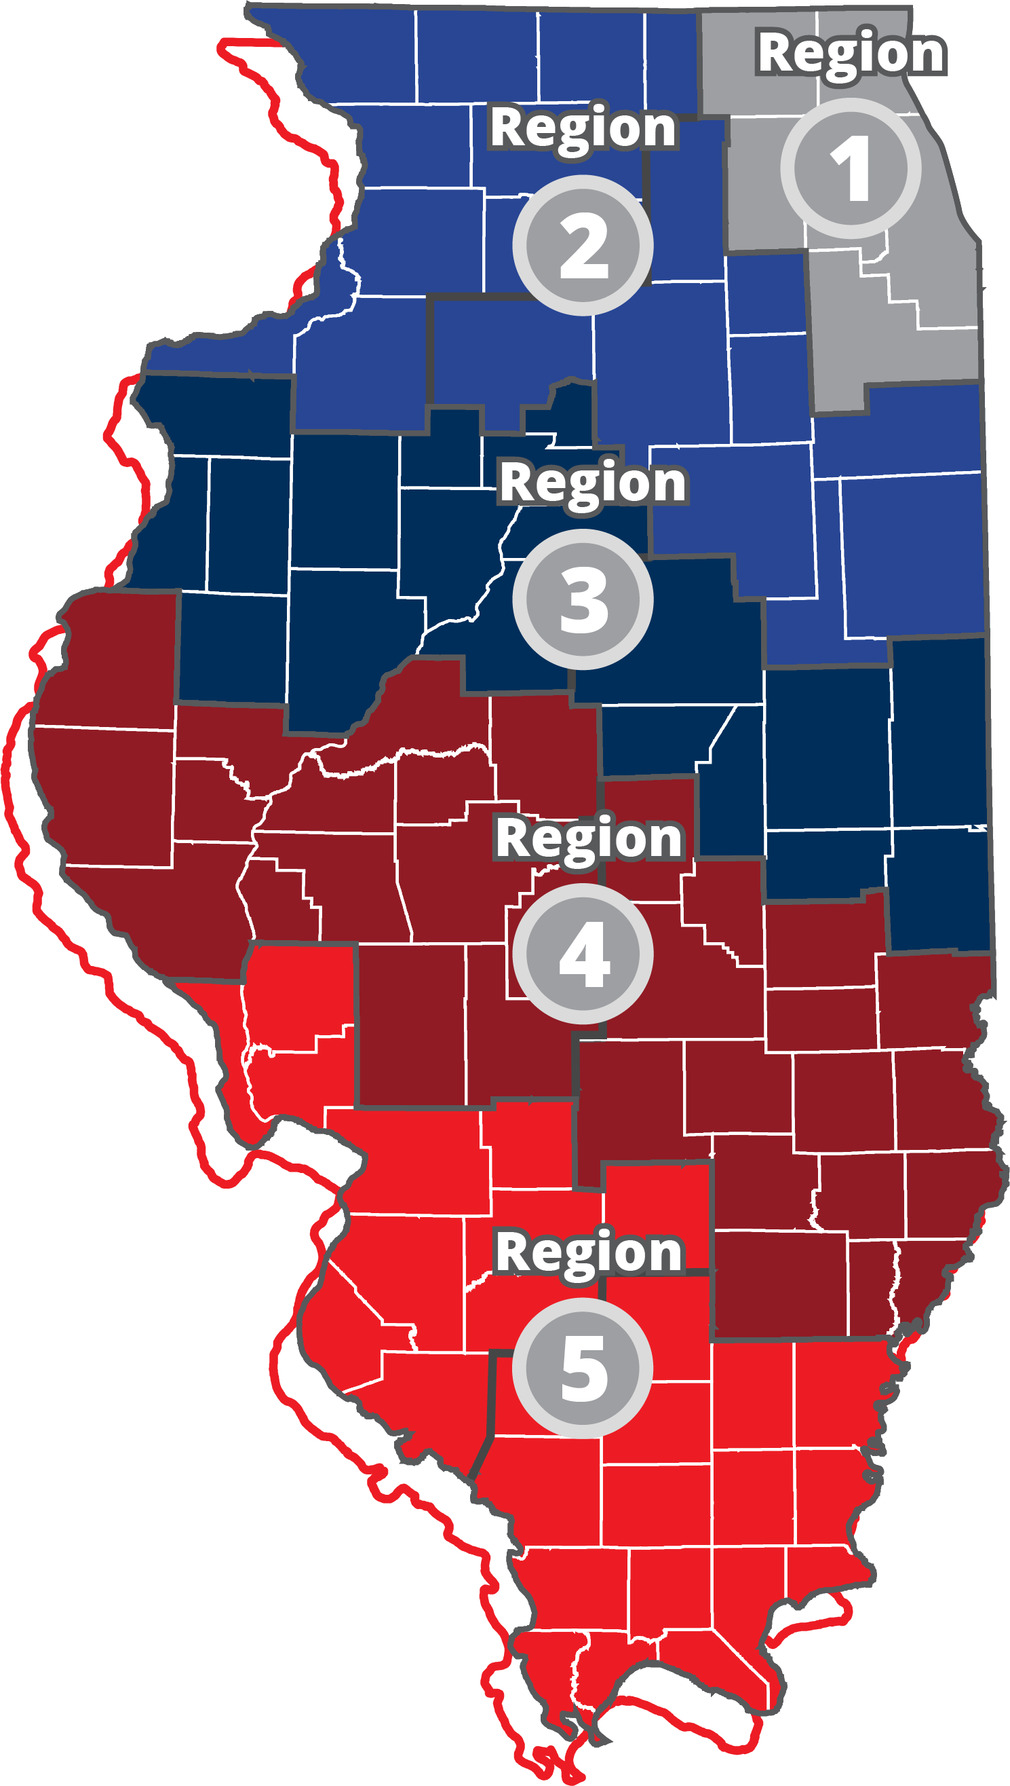


Off-Airport Freight/Cargo Impacts
$26.4
Billion
$3.0
Billion
$2.6
Billion
Over 142,000
Off-Airport Jobs
$2.1
Billion
$1.8
$35.9 Billion
Total Economic Impact
Billion
Notes:
The results of the off-airport cargo/freight analysis show that, overall, air cargo services at Illinois airports support over 142,000 off-airport jobs in the state and generate almost $36 billion in total economic impact. The jobs and total economic impact attributable to off-airport air cargo are separate from the jobs and total economic impact supported by on-airport air cargo companies. The on-airport companies contribute to an individual airport’s economic impact to the state, whereas off-airport cargo/freight economic impacts are calculated on a regional and statewide basis.
This figure shows the breakdown of cargo impacts by region; these impacts are based on the locations of industries that rely on air cargo and not the location of airports.

Slide 16
Economic Impact Results
Notes:
The following section summarizes the economic impacts by type of economic impact expressed in terms of jobs, labor income, value added, and total economic impact.

Slide 17




TOTAL Sparta Community-Hunter Field Airport Impacts
55
$2.7 M
$3.8 M
$7.3 M
Jobs
Labor Income
Value Added
Total Economic Impact
Notes:
Sparta Community-Hunter Field Airport created 55 jobs earning $2.7 million in labor income, contributed $3.8 million in value added, and generated a total economic impact of $7.3 million in 2019.

Slide 18
TOTAL Statewide Aviation Impacts
492,768
$32.5 B
$53.8 B
$95.5 B
Jobs
Labor Income
Value Added
Total Economic Impact
*Including off-airport air cargo impacts of $35.9 Billion
Notes:
At the statewide level, Illinois’ system airports supported 492,768 jobs, earning $32.5 billion in labor income, contribute $53.8 billion in value added, and generate a total economic impact of $95.5 billion in 2019. This includes a total off-airport cargo/freight impact of $35.9 billion.

Slide 19
TOTAL Region 5 Impacts
38,278
$2.6 B
$3.4 B
$6.1 B
Jobs
Labor Income
Value Added
Total Economic Impact
*Including off-airport air cargo impacts
Notes:
Region 5 created 38,278 jobs earning $2.6 billion in labor income, contributed $3.4 billion in value added, and generated a total economic impact of $6.1 billion in 2019.

Slide 20
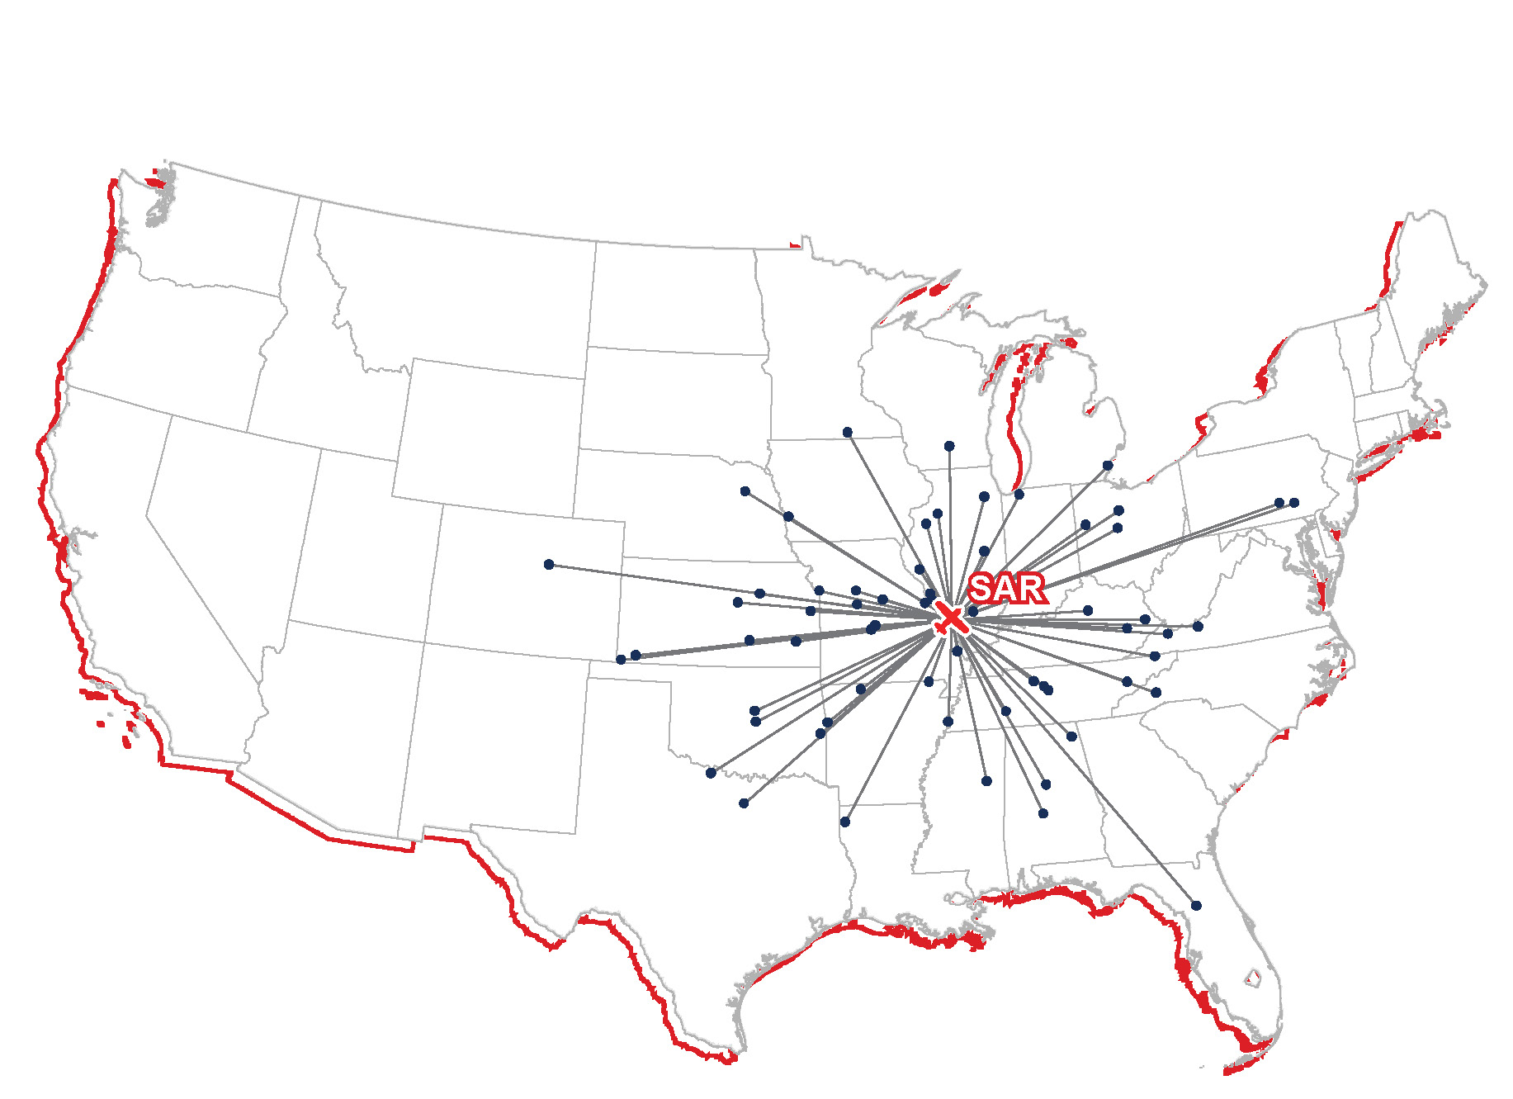
Think Sparta Community-Hunter Field Airport is Just Local?

Slide 21
Additional Aviation Benefits
Notes:
The following section provides additional aviation benefits that are not quantified in the previous slides.

Slide 22
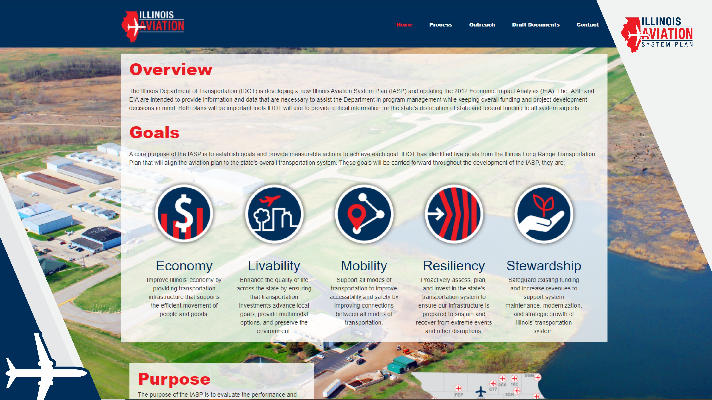
Project Website
ilaviation.com
Notes:
The final study documents for both the Illinois Aviation Economic Impact Study and Illinois Aviation System Plan are available online at www.ilaviation.com. The website also includes individual airport brochures that can be downloaded for all airports included in the scope of the study.

Slide 23

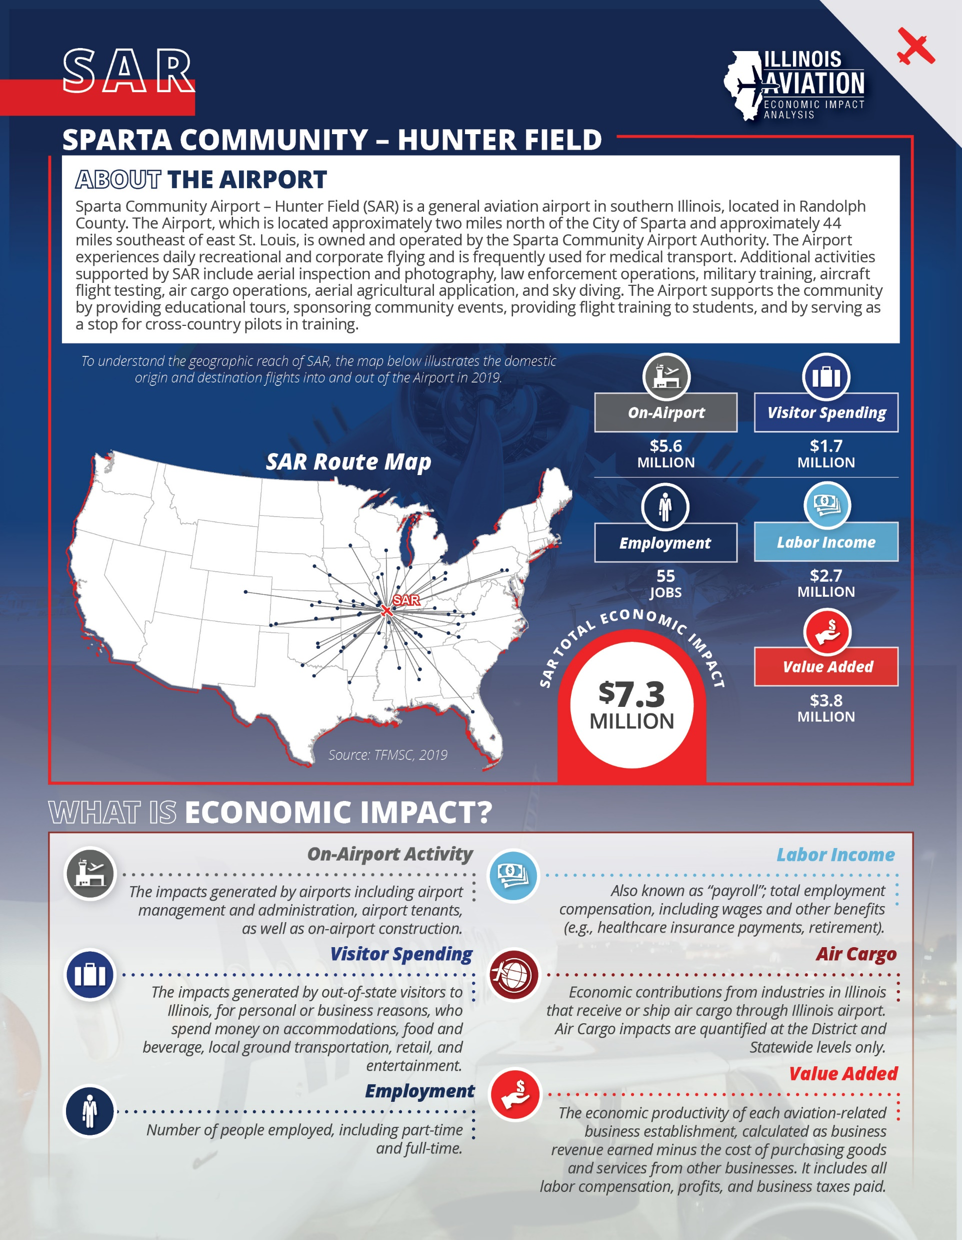
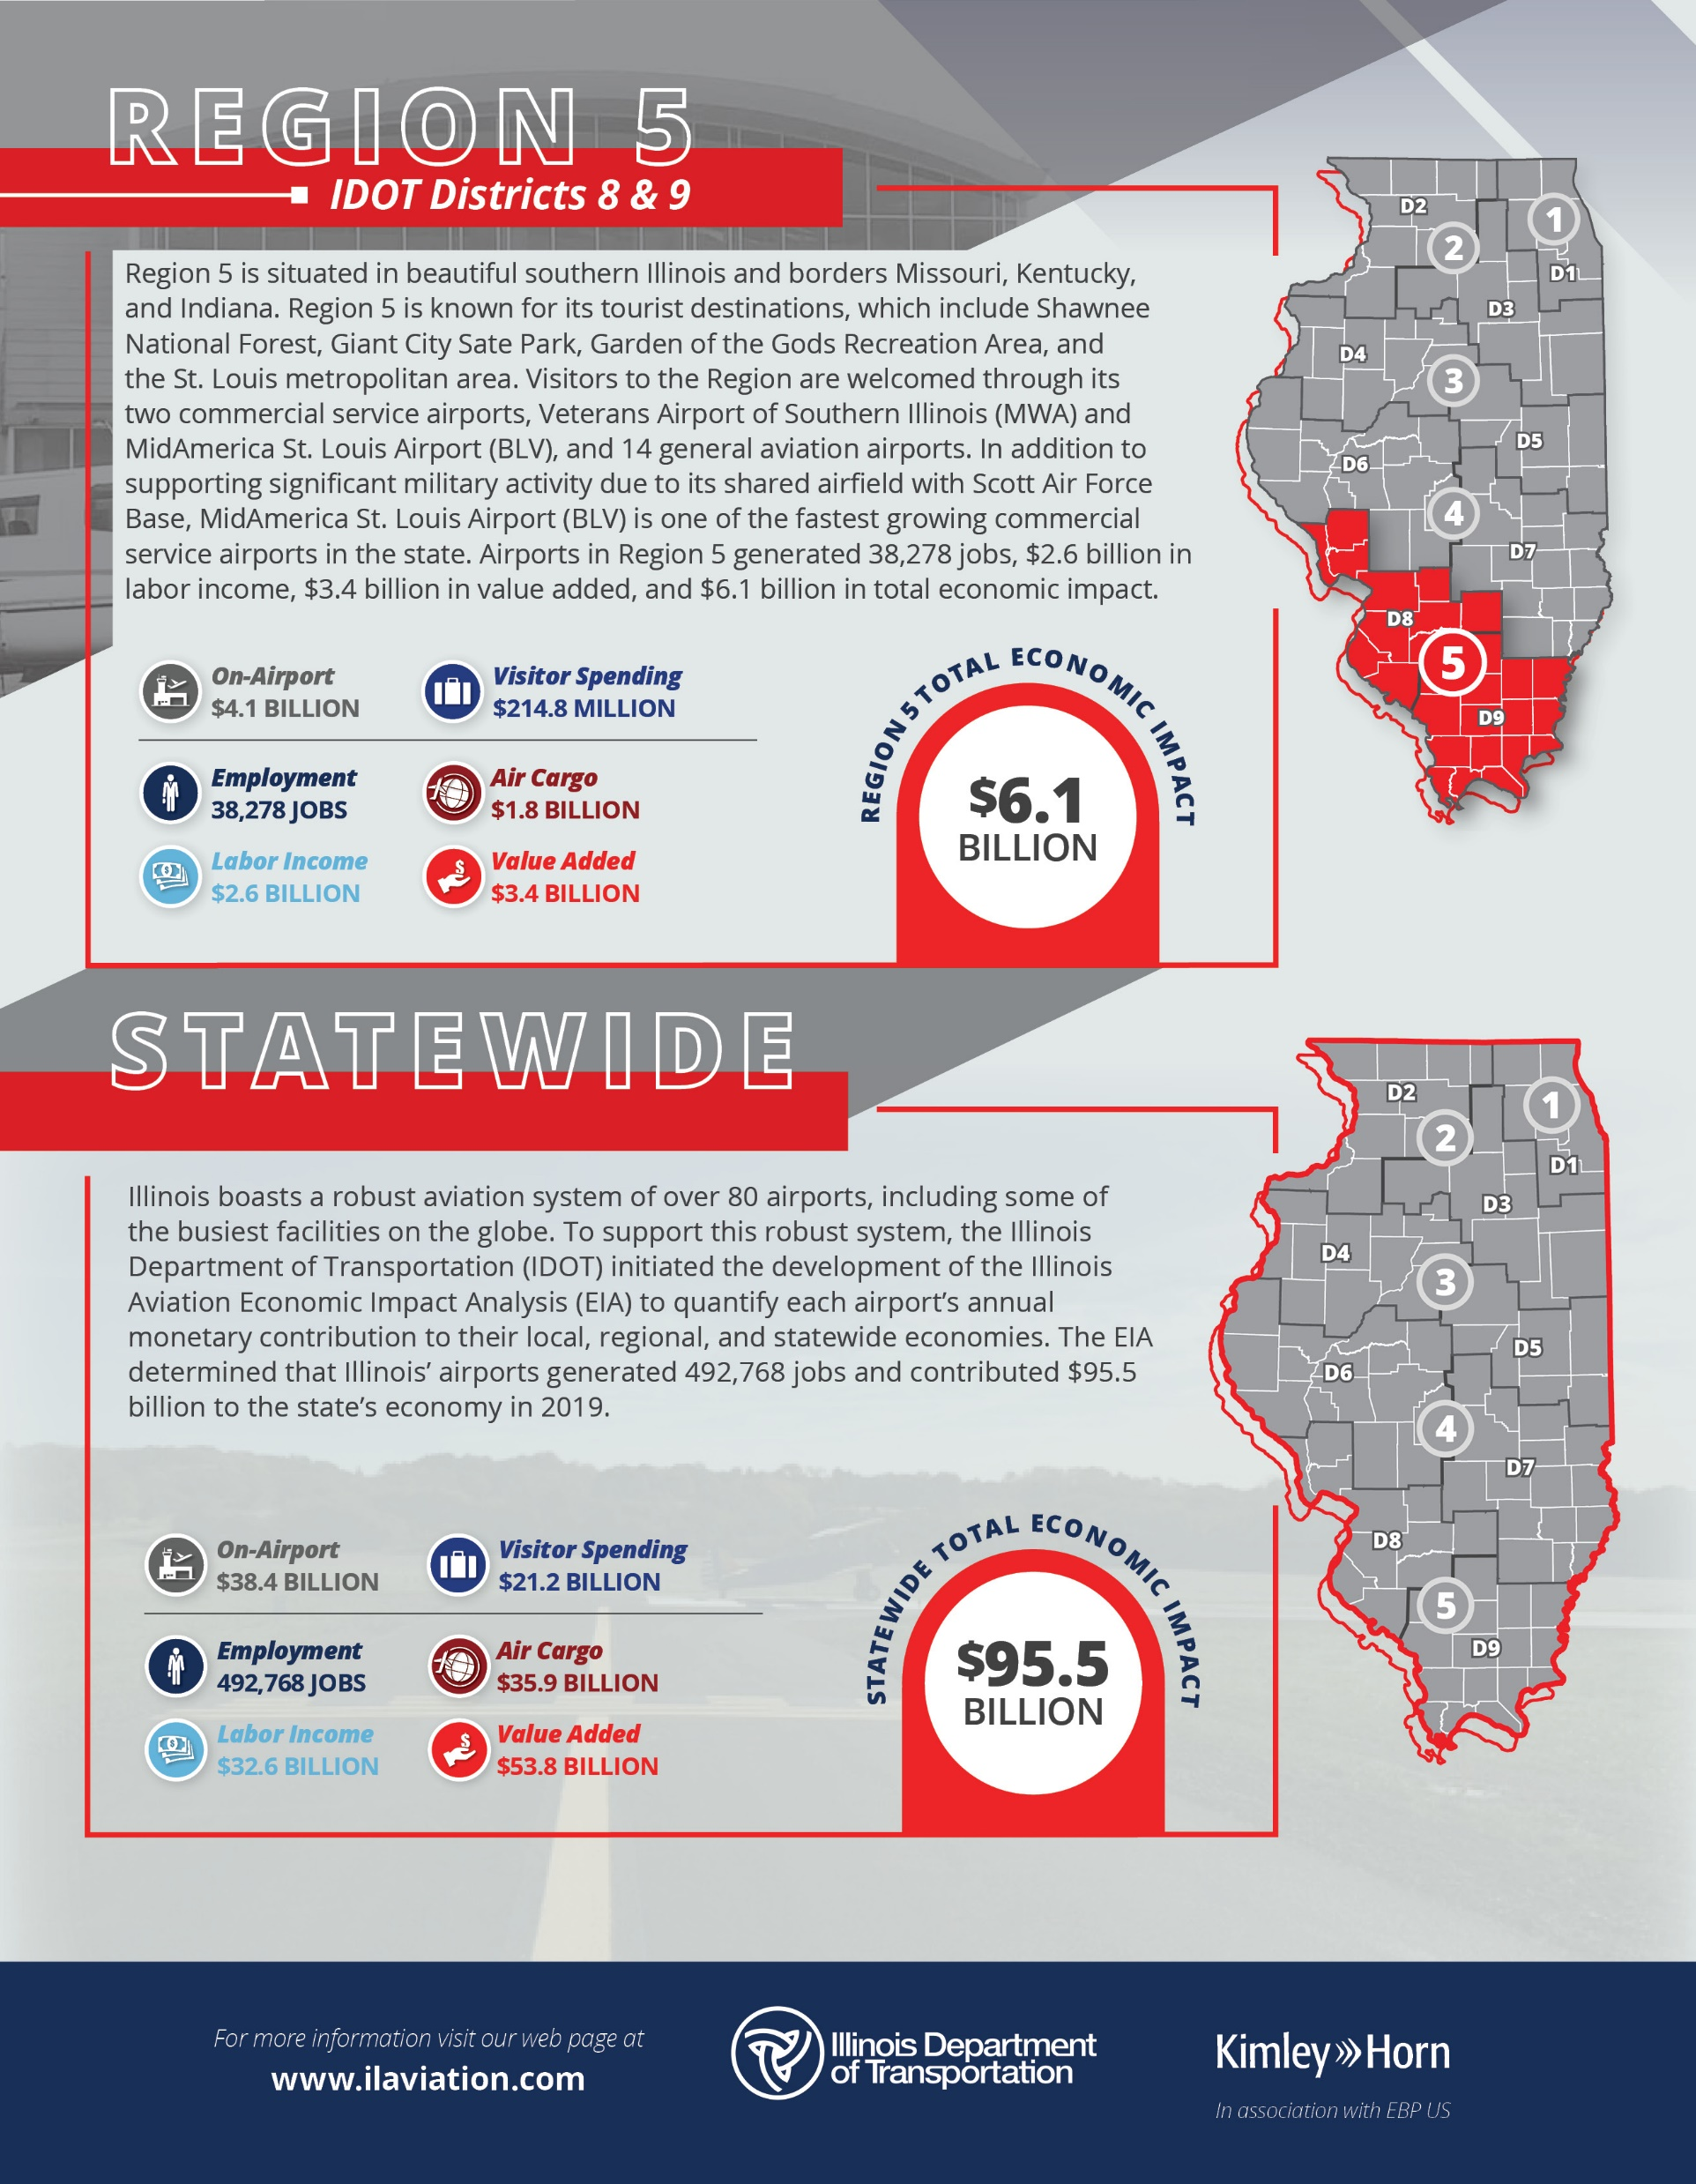
Start Spreading the News!
Notify local and regional stakeholders
Communicate results with local and regional government officials
Communicate results with local media
Upload results to airport website

Slide 24
Contact
BJ Murray
Section Chief, Aviation & Marine Transportation Program Planning
217.782.4118
BJ.Murray@illinois.gov
Airport Presenter Name
Role
Phone
Email

